Slide 1
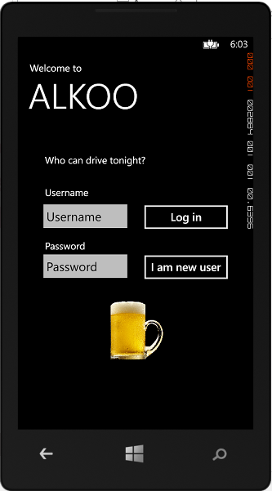
ALKOO
Stefan Grönroos, Petteri Karvinen, Anders Berg, Shohreh Hosseinzadeh, Natalia Díaz Rodríguez
Embedded Systems Lab.
Åbo Akademi University, 2013

Slide 2
ALKOO – low cost pocket alcohometer
Constructed low-cost sensor with
Arduino board
UI prototype working
Input:
Weight
Sex
Start time of drinking.
Output:
Estimated drink units drank and
Ethanol level in blood.

